Slide 1
3D EBSD Setup Guide
Eric Viklund

Slide 2
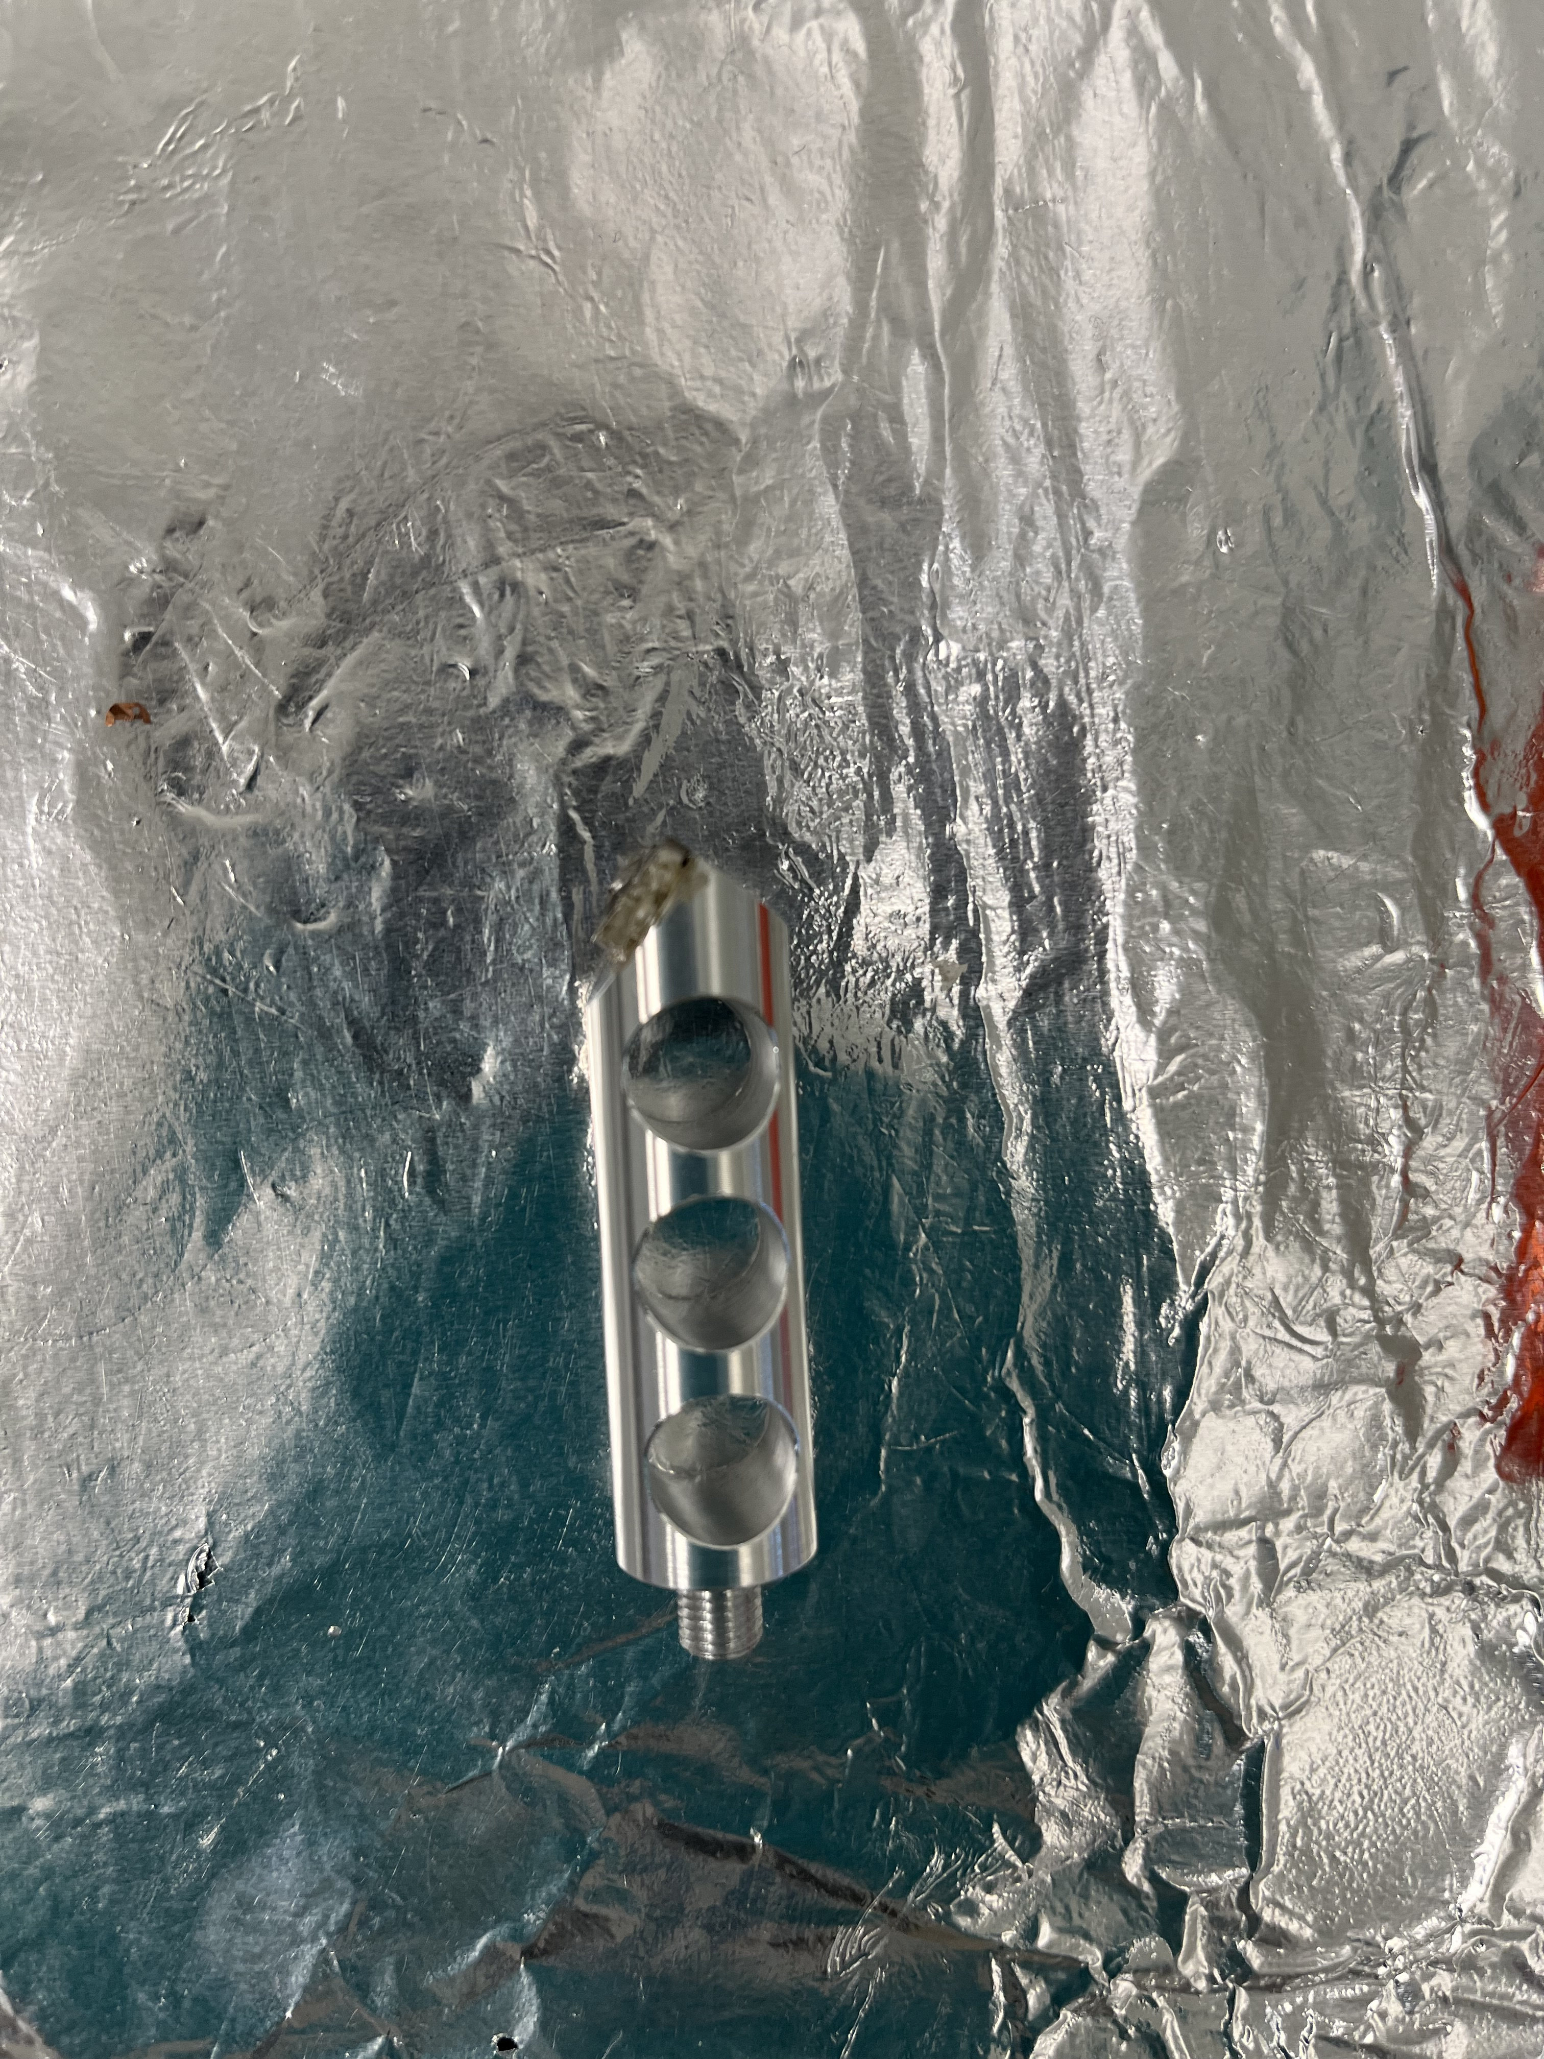
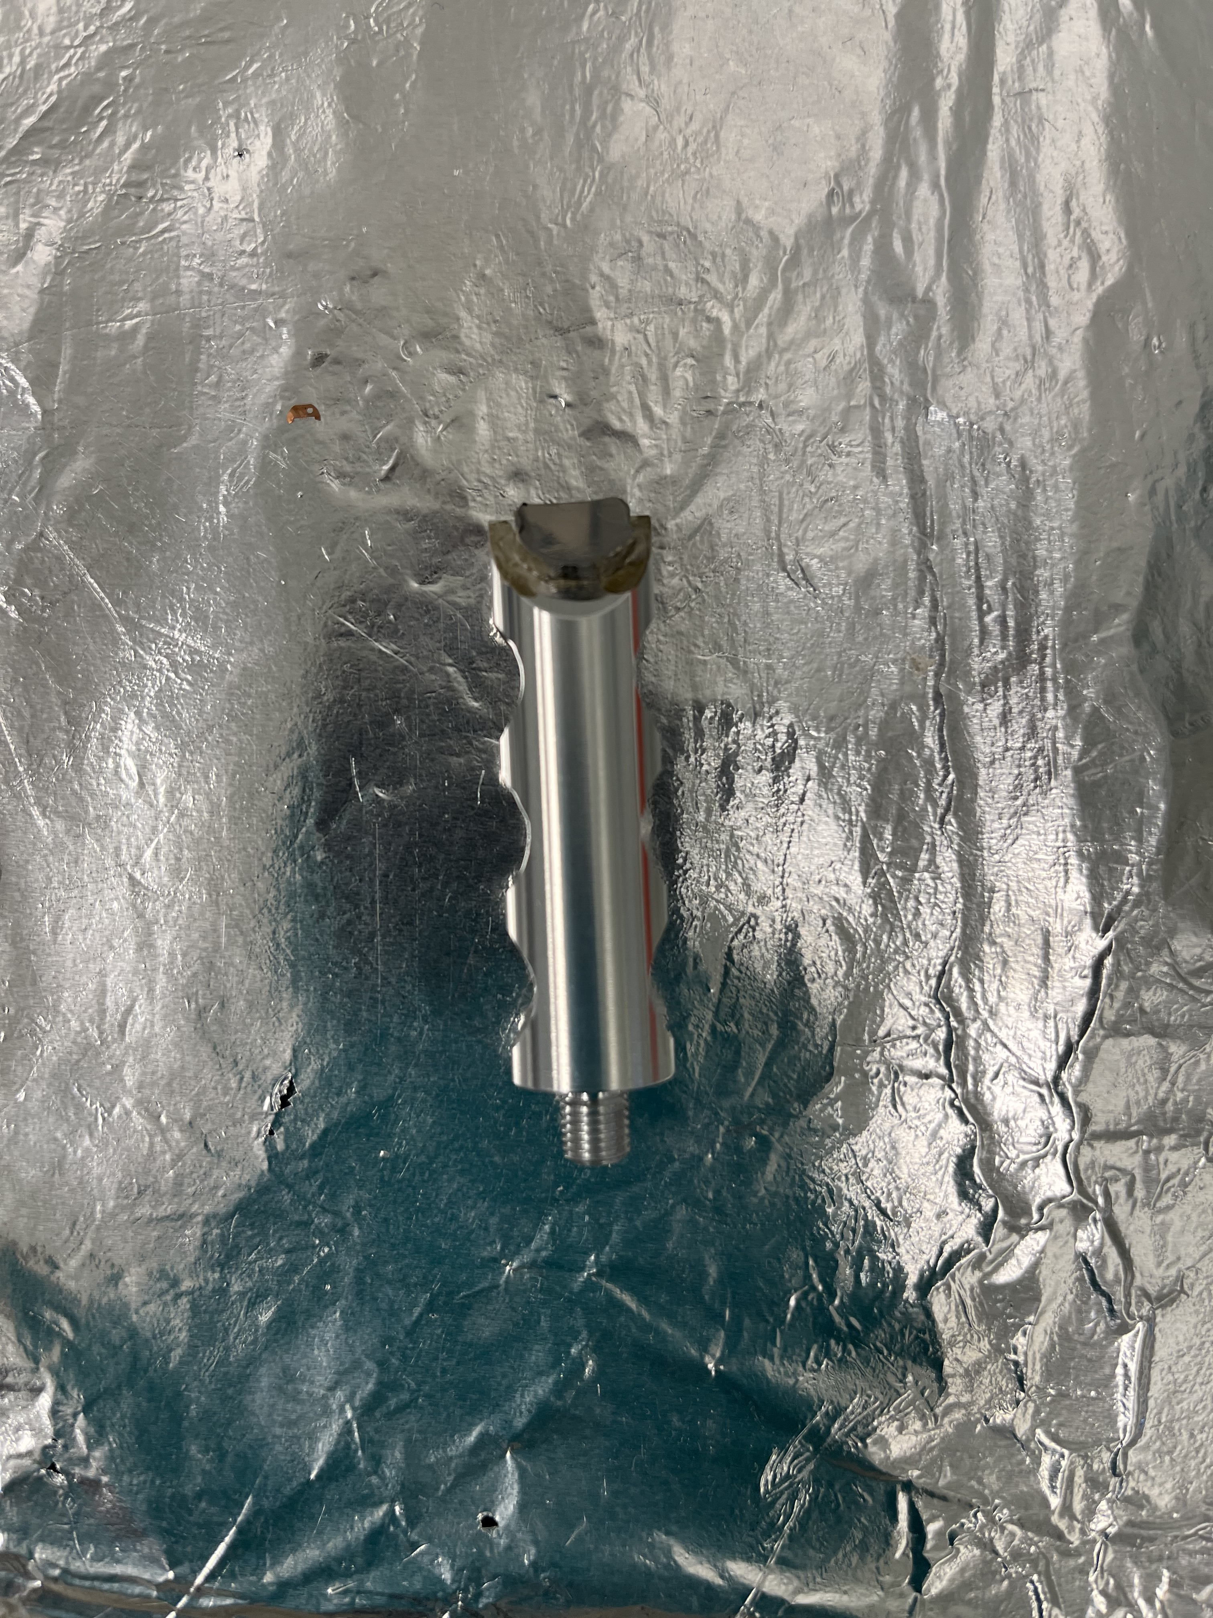
Sample Preparation
Mount the sample on the 54° side of the pre-tilt sample holder.
Use silver paste to prevent sample drift during the measurement.

Slide 3
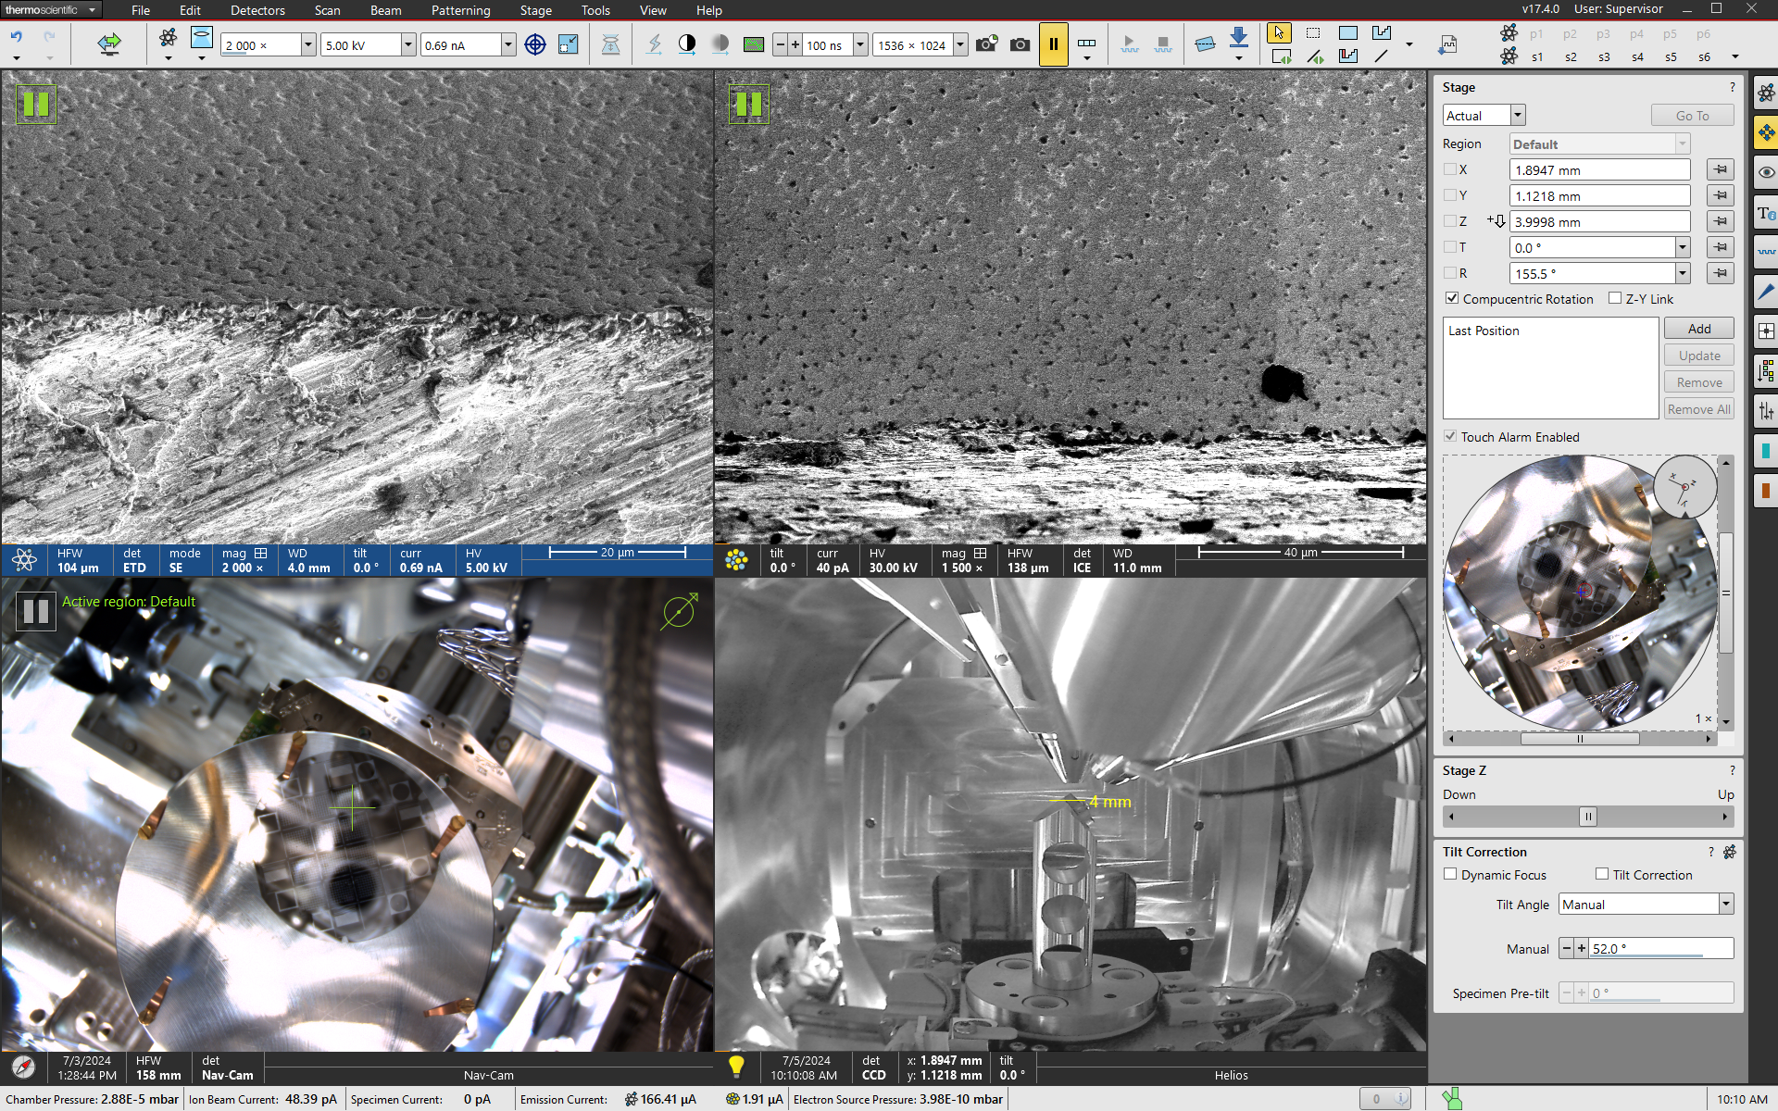
Eucentric Height Beam Alignment
Locate area of interest near sample edge.
Align electron and ion beam at eucentric height.

Slide 4
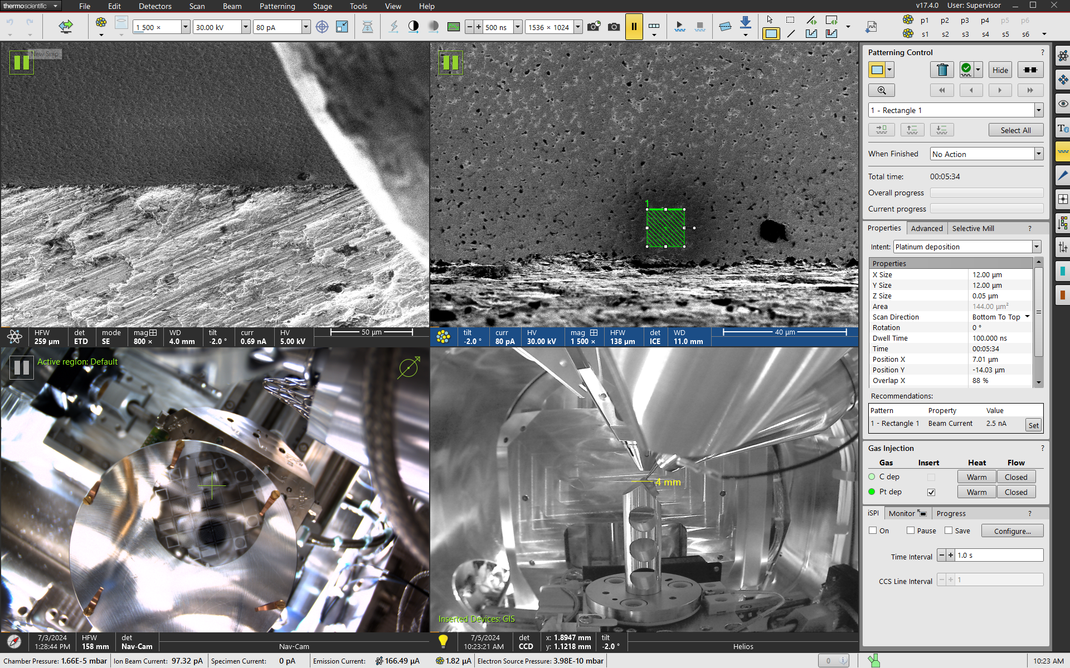
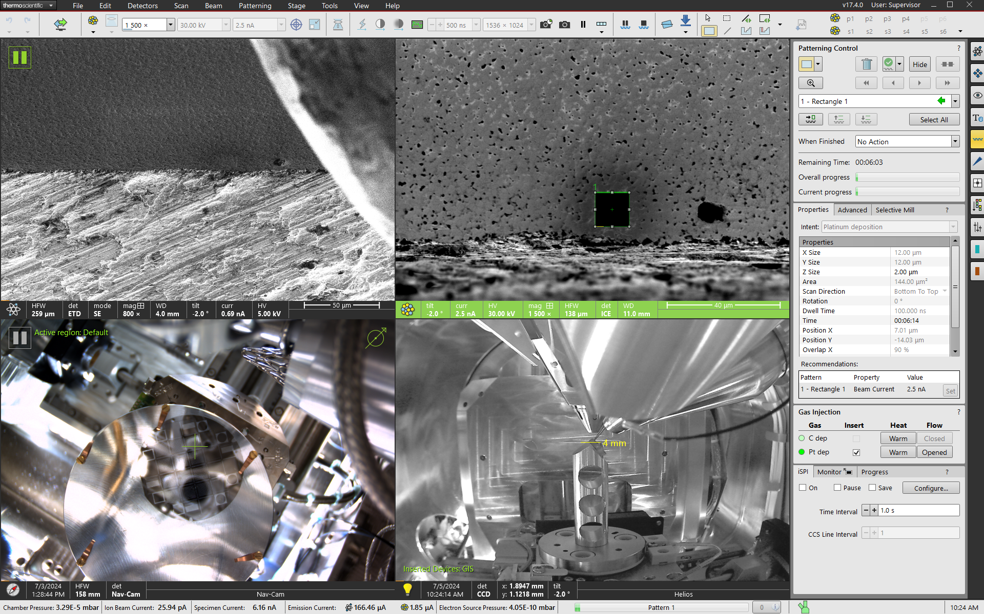
Capping Layer
Deposit an initial thin Pt layer with low current.
Deposit 2μm Pt layer on top of initial layer.
Cap should be slightly larger than the area of interest

Slide 5
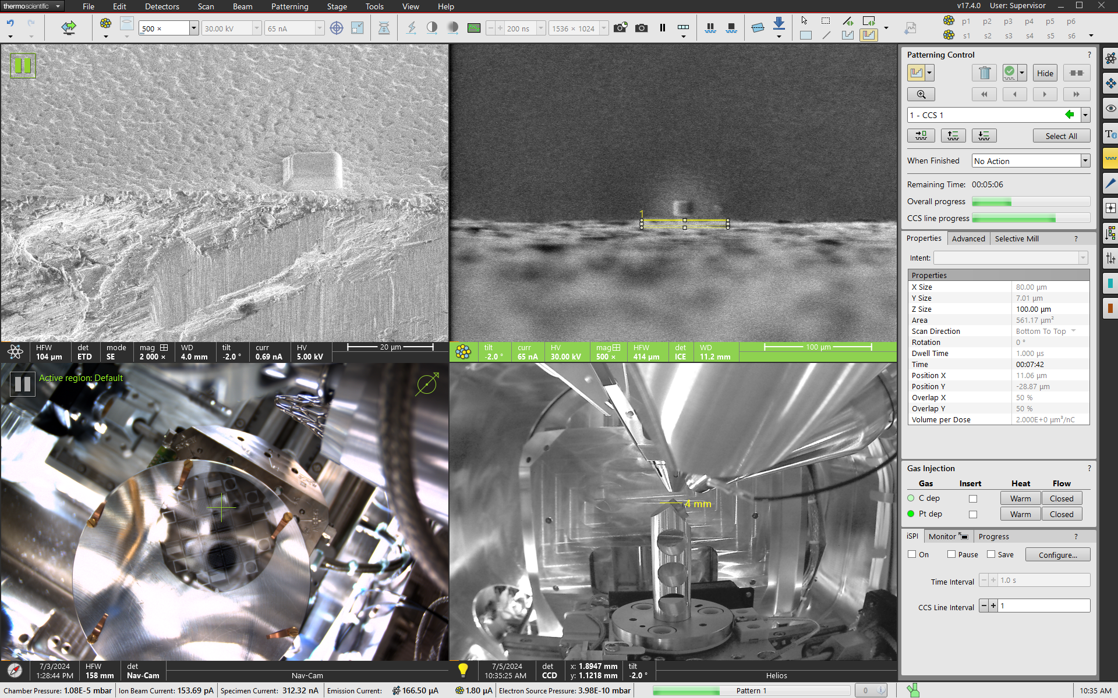
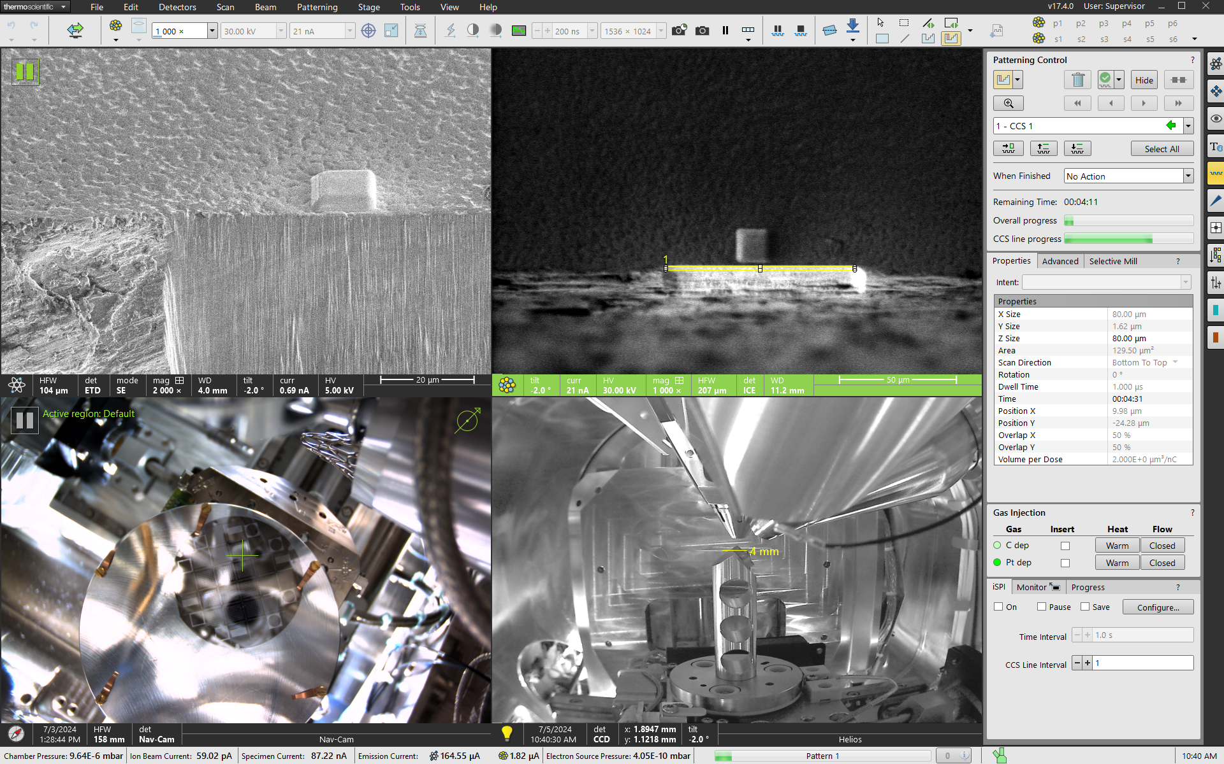
Rough Cleaning
Use a high ion beam current (≥65nA) to mill away the rough edge of the sample.
The cleaning area should be much wider than the area of interest.
Decrease the beam current as cleaning progresses to avoid milling of the Pt cap.

Slide 6
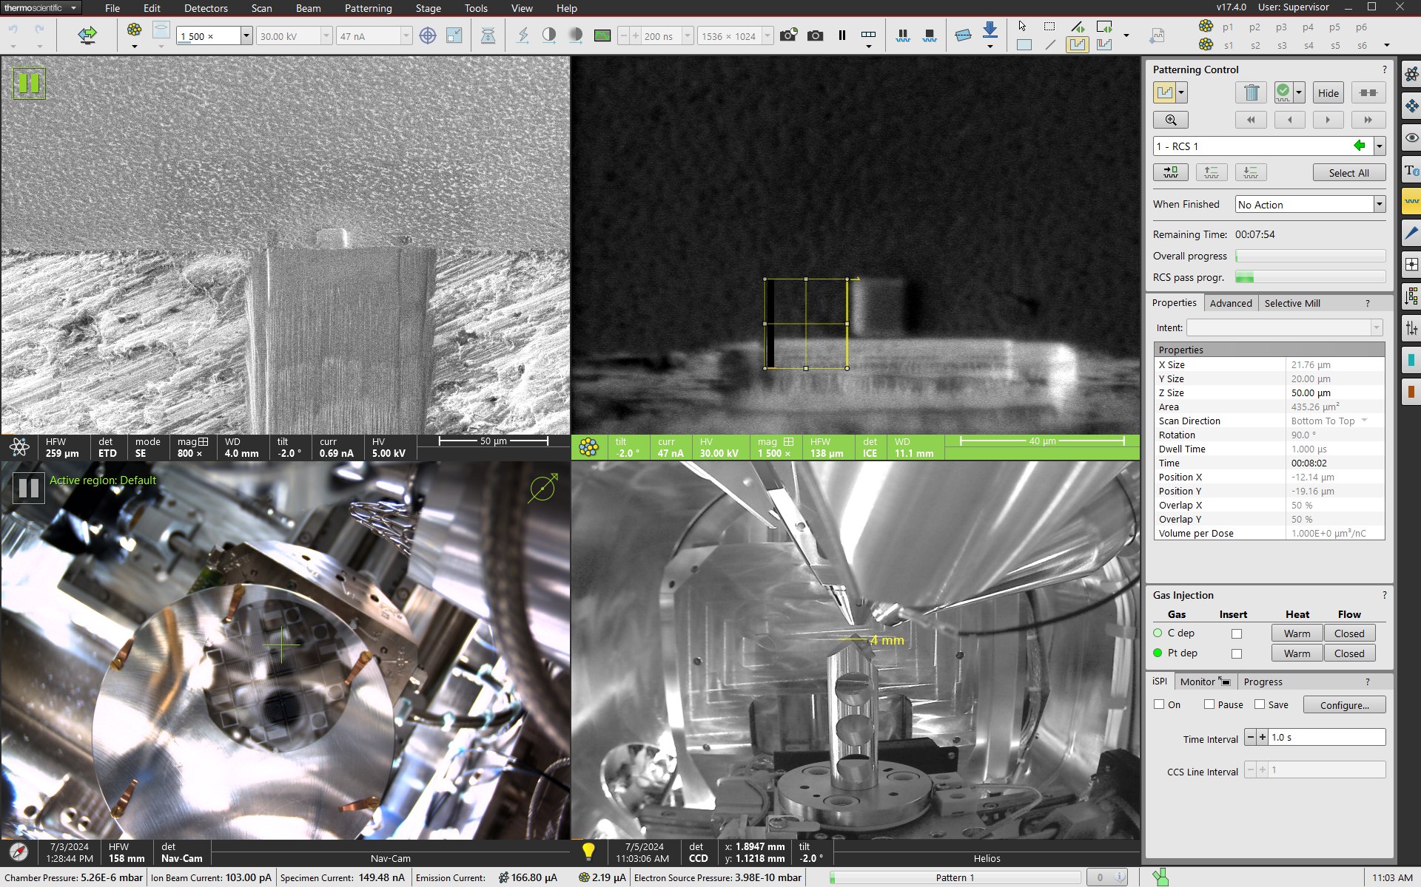
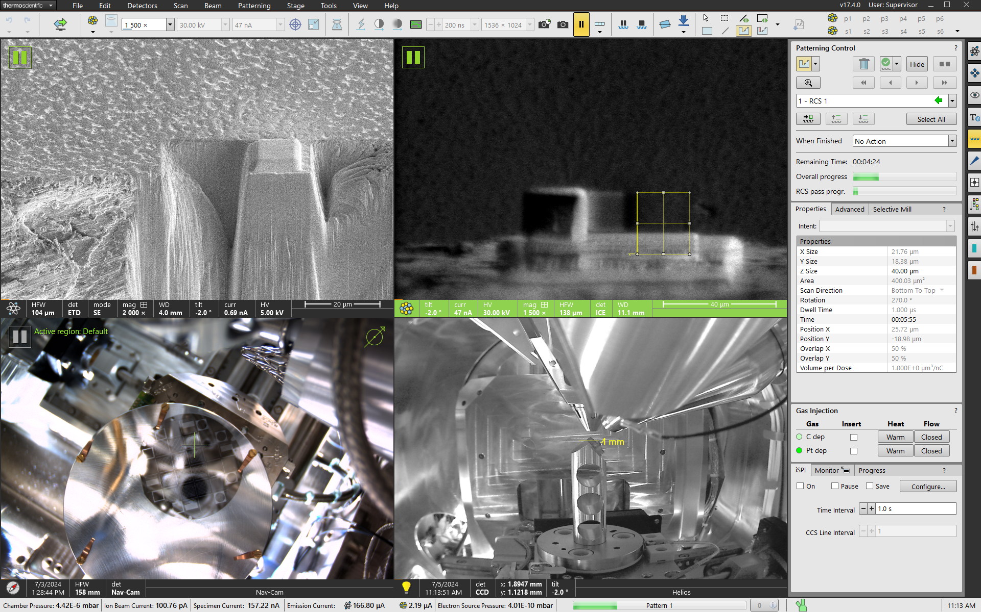
Trench Milling
Mill a trench on each side of the area of interest.
The trenches should be larger than the area of interest.

Slide 7
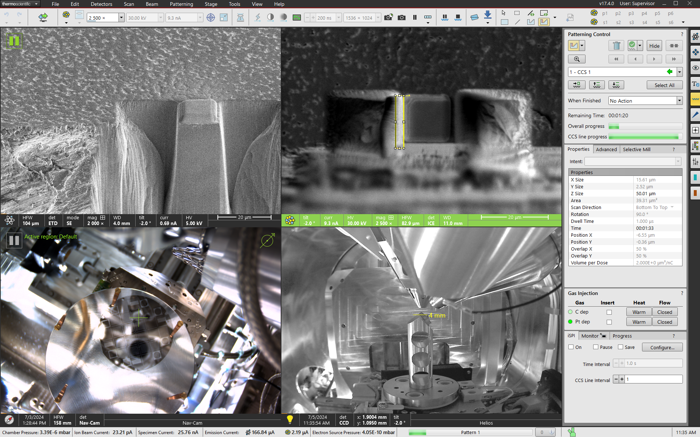
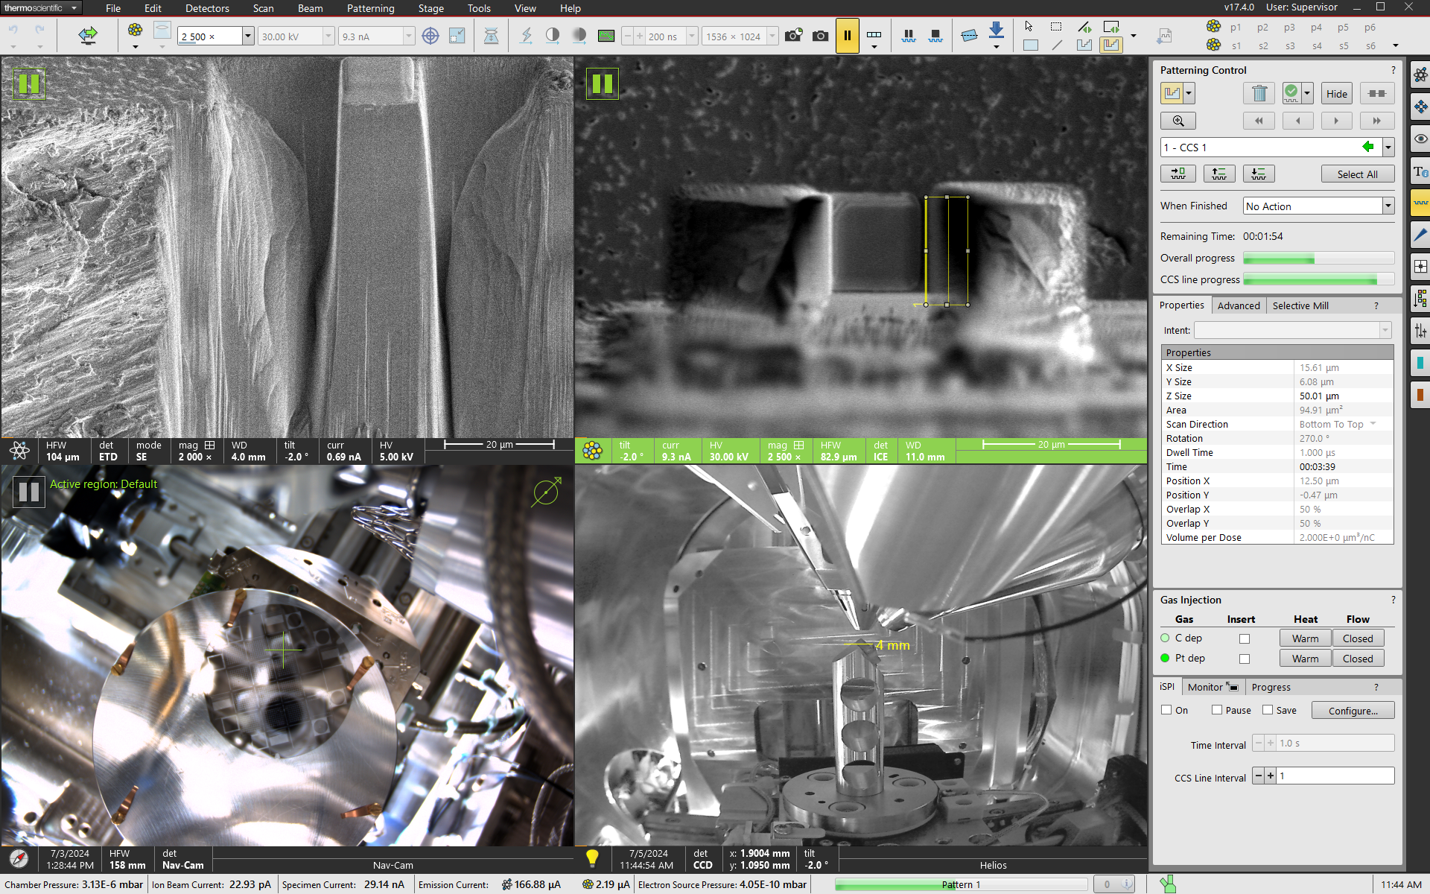
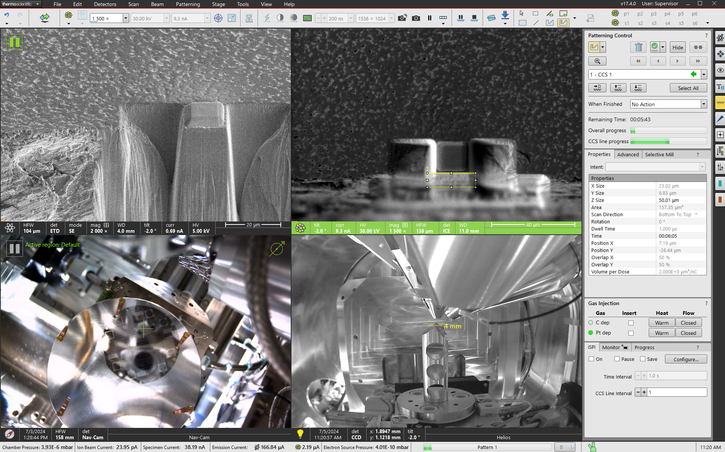
Fine Cleaning
Use the cleaning cross section to clean the three sides of the area of interest.

Slide 8
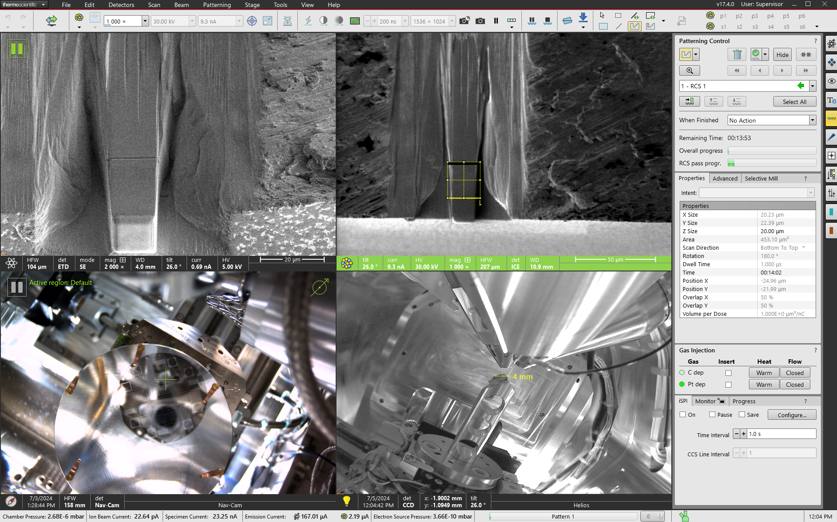
Undercut
The undercut is optional but highly recommended to reduce slice milling time.
Rotate the stage 180° and tilt the stage to
Use the trench cut to remove material underneath the area of interest.

Slide 9
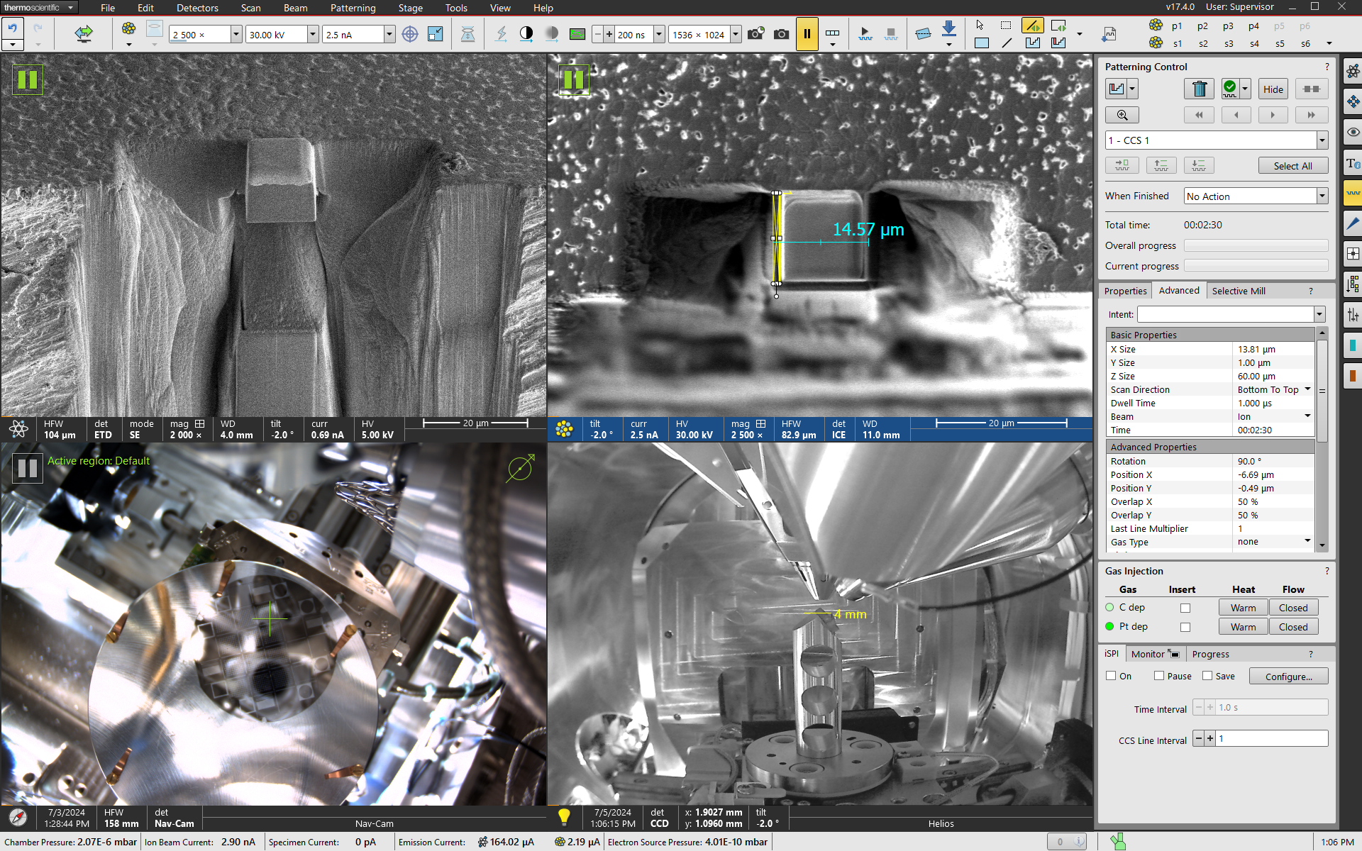
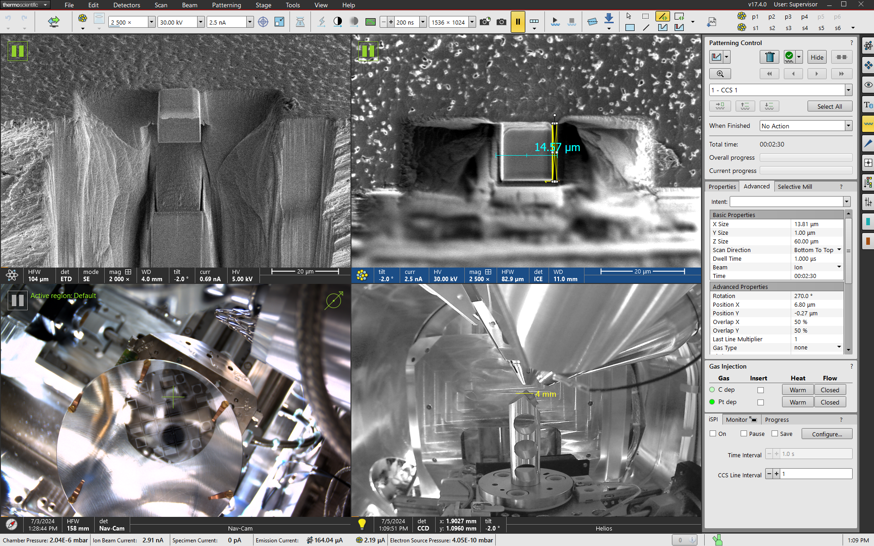
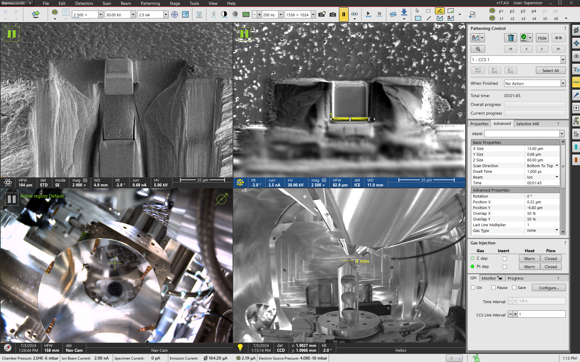
Fine Cleaning 2
Use the cleaning cross section to clean the three sides of the area of interest.

Slide 10
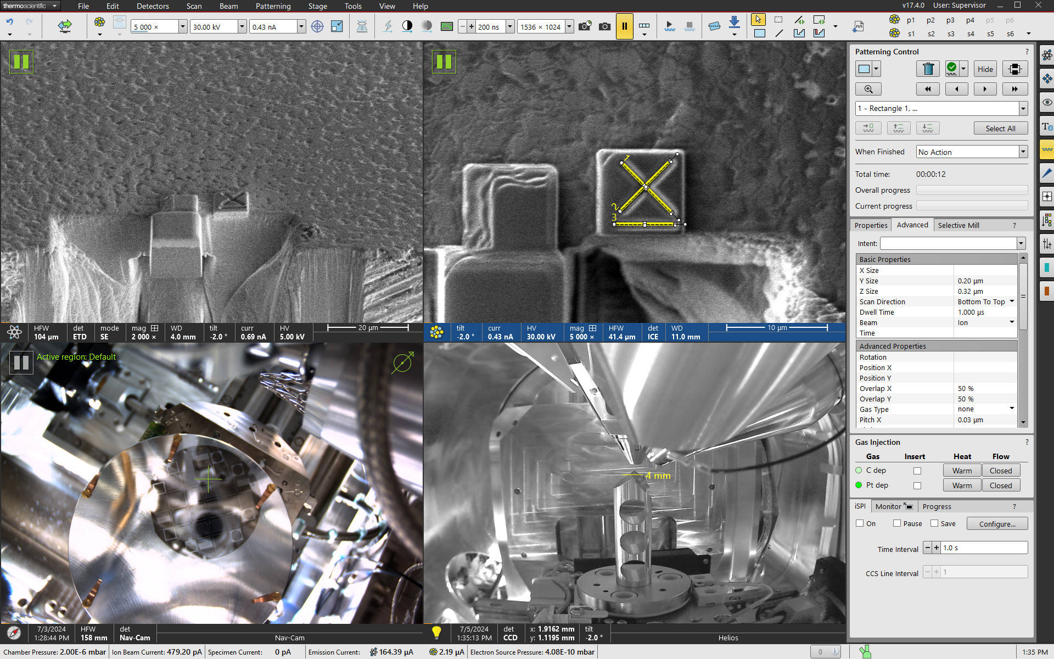
FIB Alignment Fiducial Mark
Deposit 1-2 μm Pt cap on the sample close to the area of interest.
Mill a fiducial mark onto the cap.
A thin line will create higher contrast than a thick line.
The ASV software can use a horizontal line feature to better align the image in the slice direction.

Slide 11
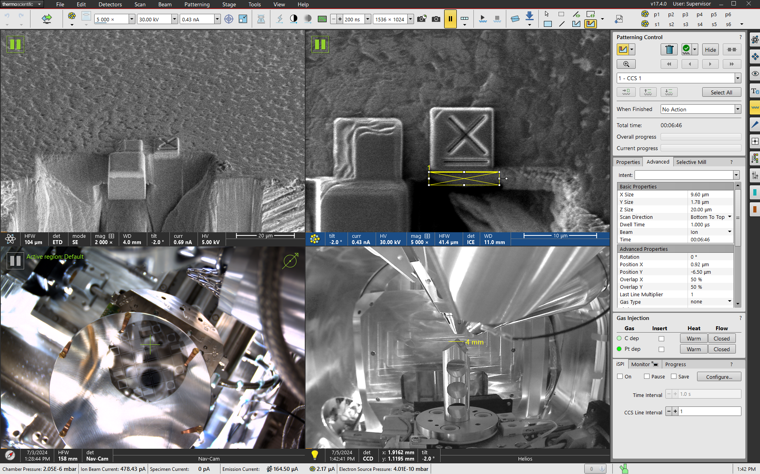
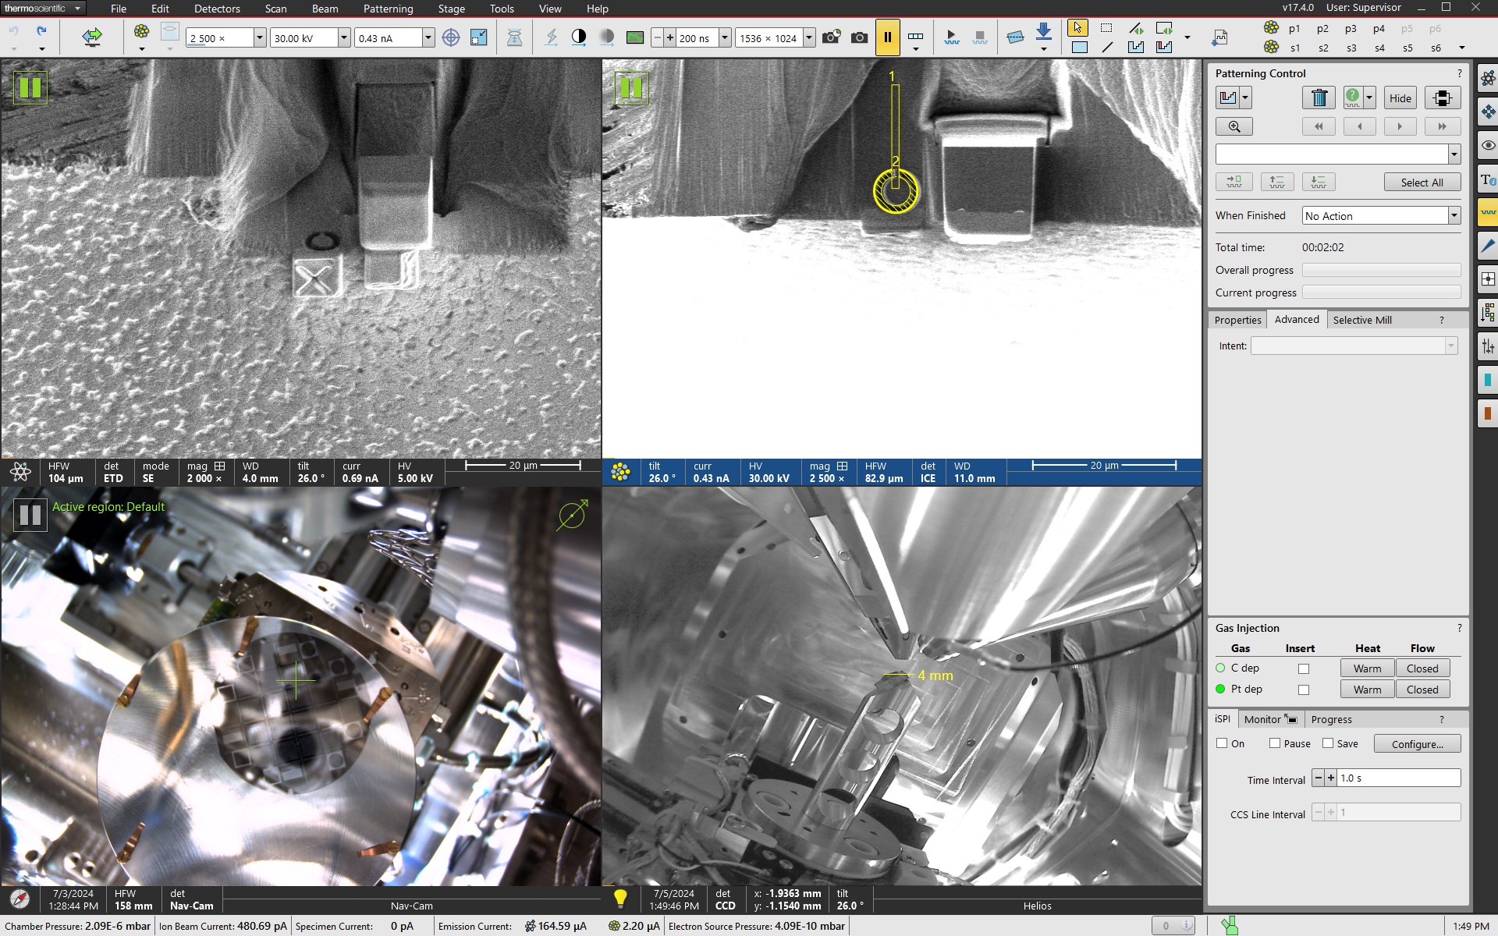
EBSD Alignment Fiducial Mark
Create a fiducial mark on the side face of the sample to be used for EBSD alignment.
Any non-radially symmetric shape can be used.

Slide 12
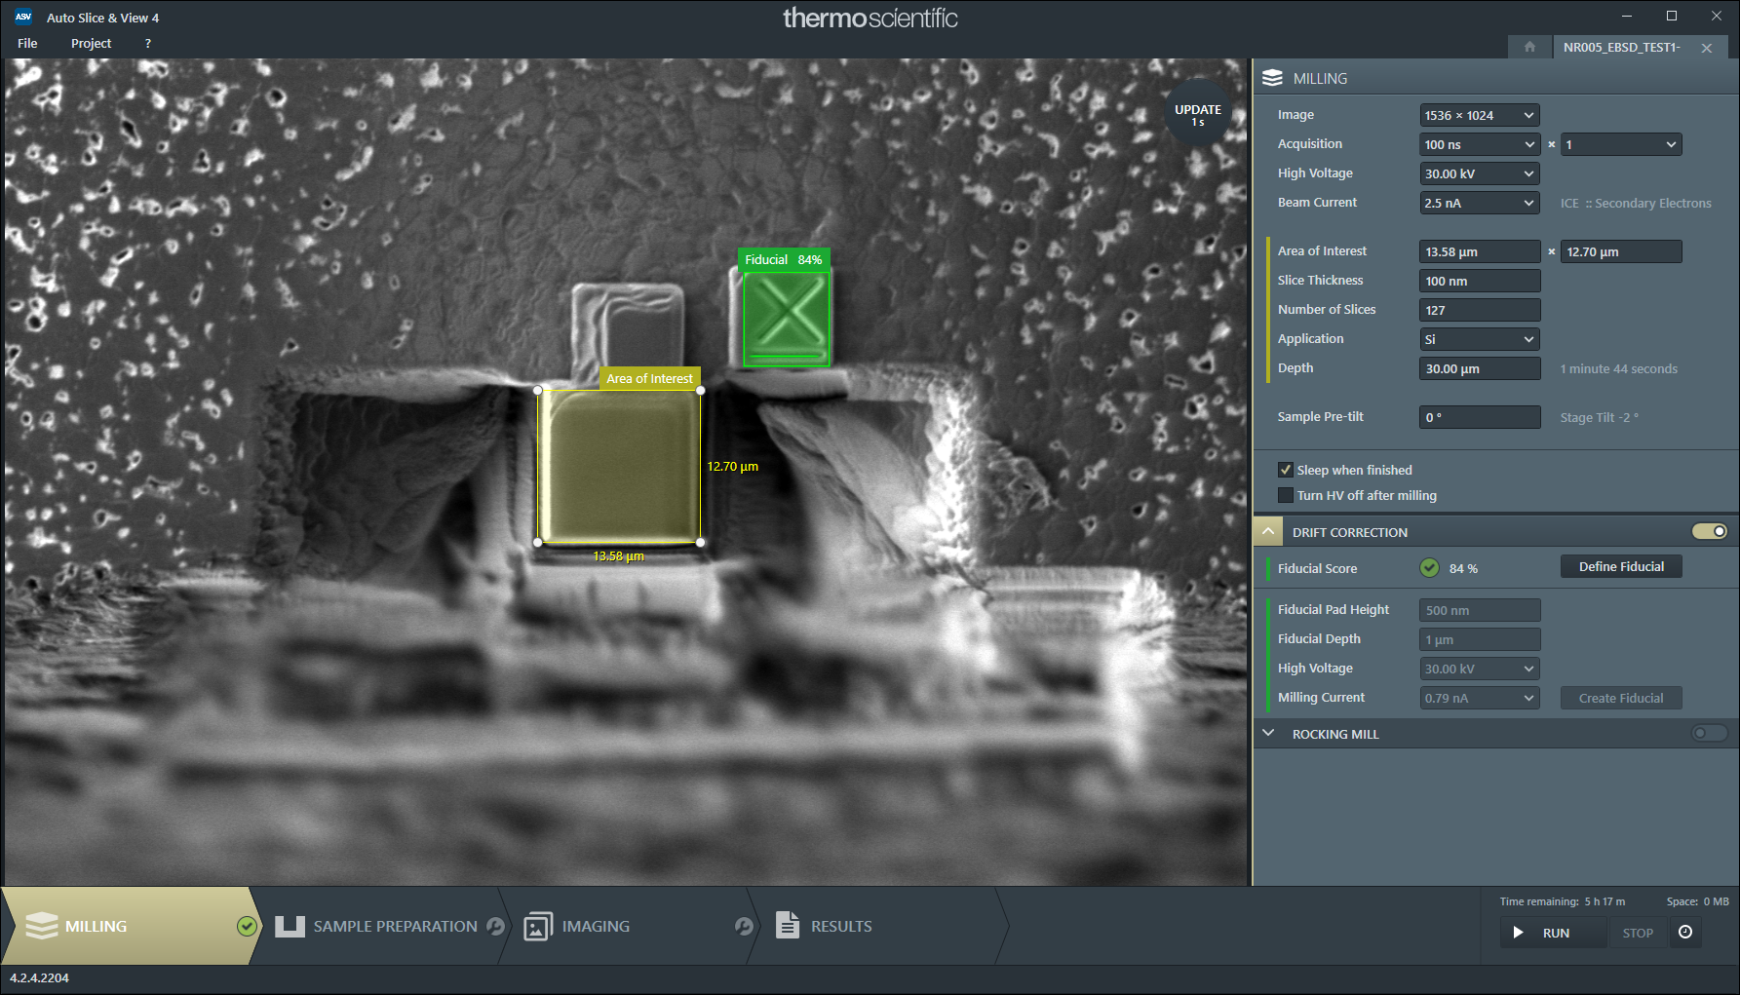
ASV Milling Setup
Set the FIB milling parameters, slice thickness, and slice depth.
Expand the Area of Interest so it covers the entire sample.
Make sure that the bottom edge lines up exactly with the bottom edge of the sample.

Slide 13
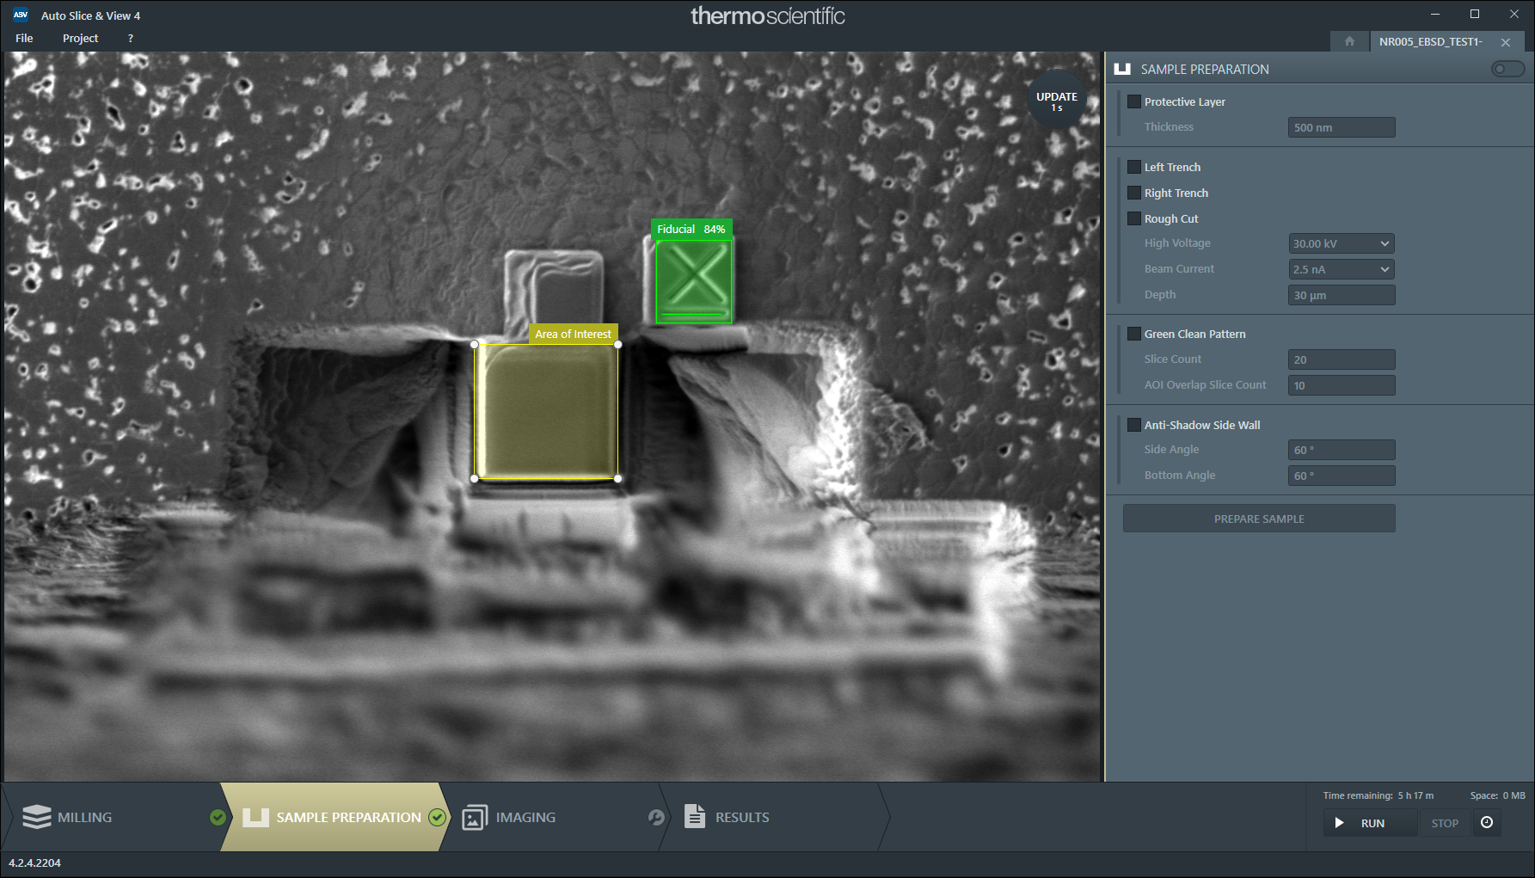
ASV Sample Preparation Setup
Uncheck the sample preparation switch to proceed without sample preparation.

Slide 14
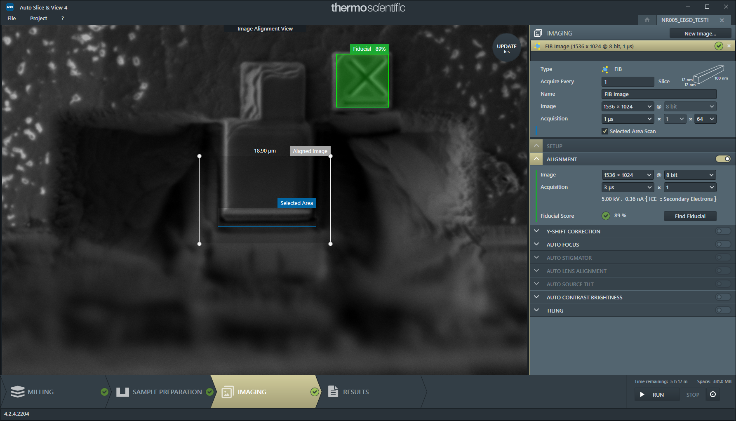
ASV Rough Polishing
Remove all the default imaging steps by clicking the white ‘x’ on each of them.
Click the ‘New Image’ button and add a FIB Image.
Set the FIB beam to 5 kV and 0.36 nA.
Activate and configure the alignment feature.
Activate the selected area scan and adjust the acquisition time until the total duration is ~20-30 seconds. A longer acquisition may cause the program to get stuck.

Slide 15
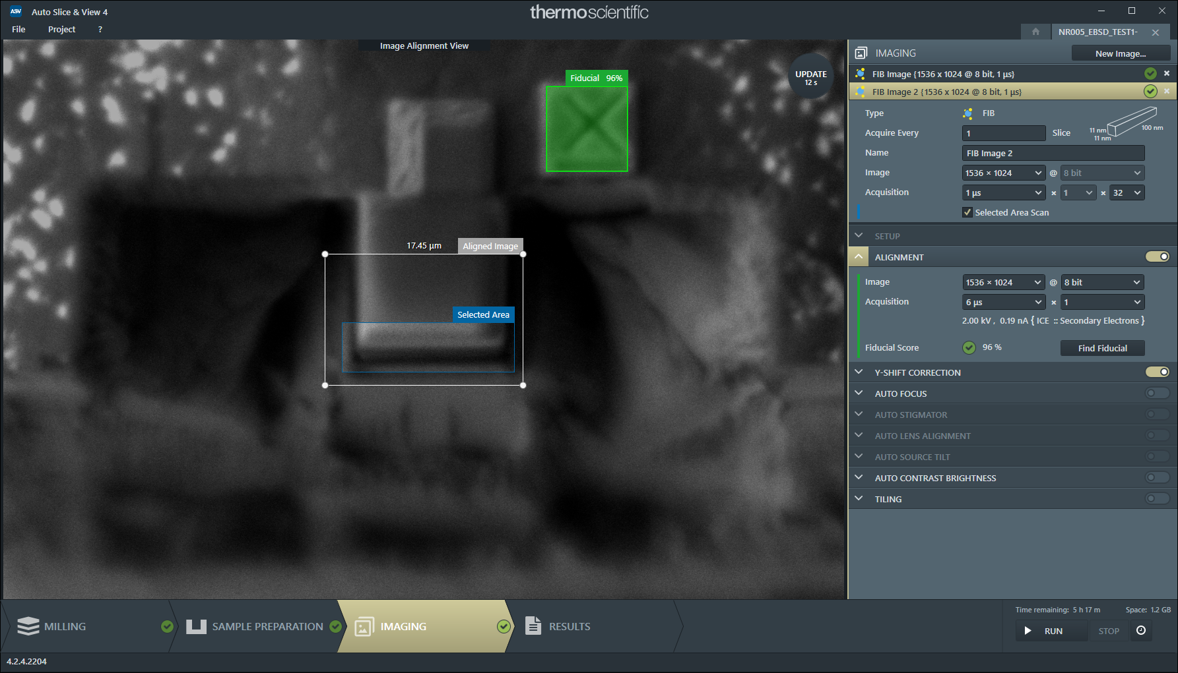
ASV Fine Polishing
Create a second FIB image for fine polishing of the cut face.
2 kV and 0.19 nA
Activate and configure the alignment feature.
You may need to increase the acquisition duration on the alignment image if the image is too noisy for the alignment to detect the fiducial mark.
Activate the selected area scan and adjust the acquisition time until the total duration is ~20-30 seconds.

Slide 16
Extra Notes on Polishing
If the EBSD map has many poorly indexed pixels it is likely due to insufficient polishing.
Adding a 3rd polishing step may be required. Alternatively, increase the beam current.
Creating a larger fiducial mark with high contrast will make the alignment of the FIB polishing much easier allowing for higher beam current.

Slide 17
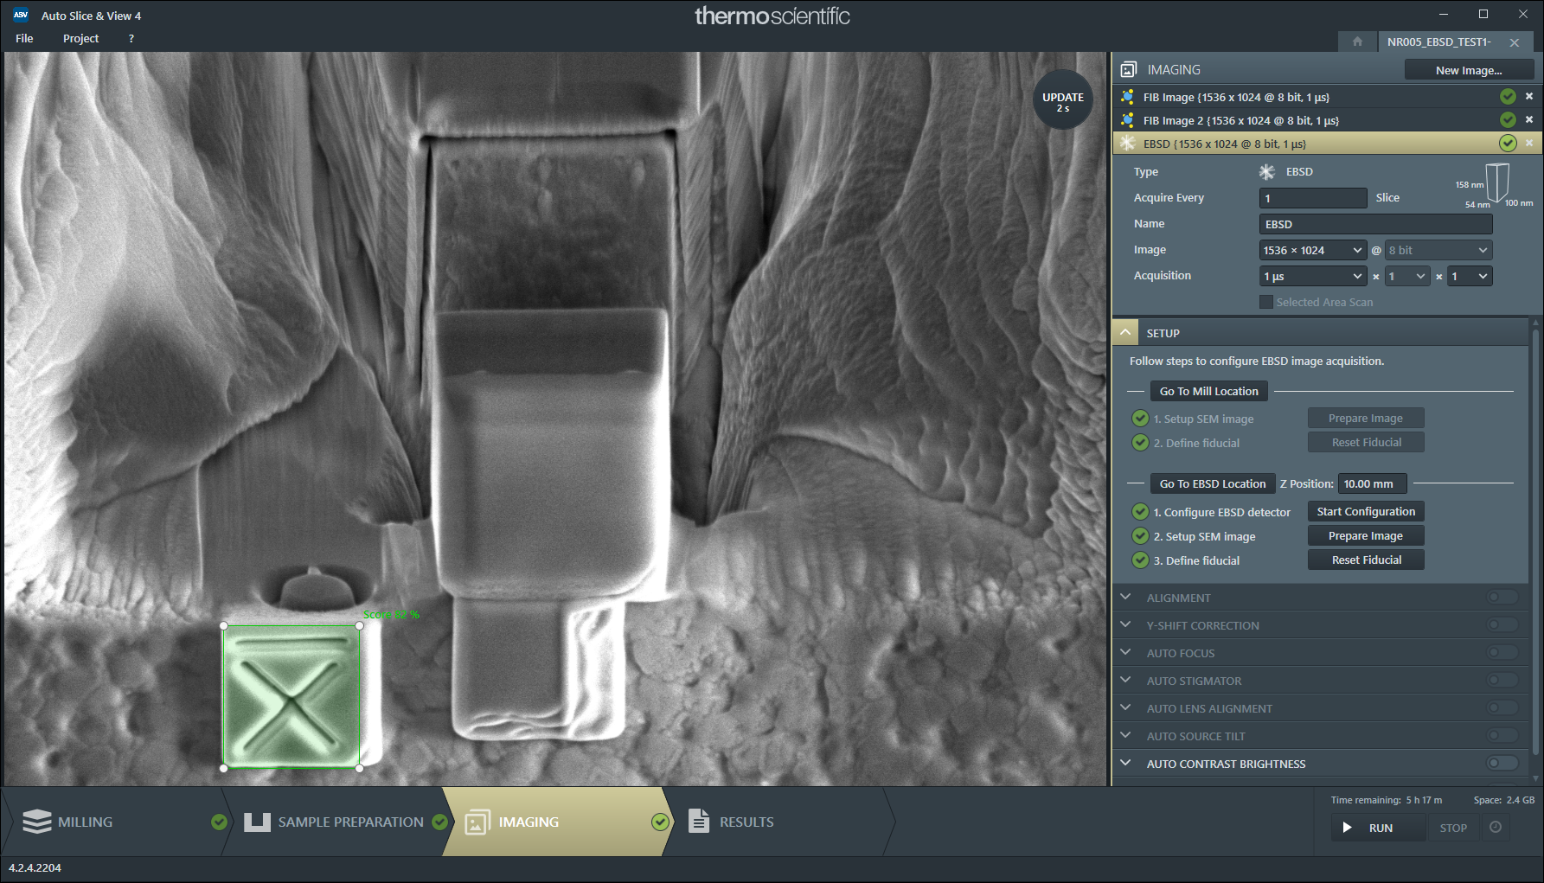
ASV EBSD Setup
Create a new EBSD Image.
Follow the setup guide by clicking
‘Go To Mill Location’
‘Prepare Image’
‘Find Fiducial’
Before clicking ‘Go To EBSD Location’ set the Z Position field to 10.00 mm.
Once you click ‘Start Configuration’ the Aztec Software should start up automatically.

Slide 18
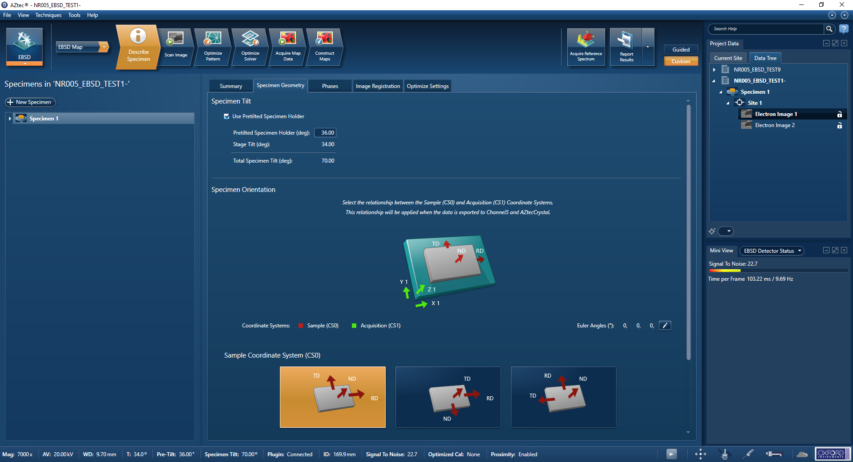
Aztec Setup – Set Sample Tilt
Under the ‘Specimen Geometry’ tab check the ‘Use Pretilted Specimen Holder’ box and set the pretilt angle to 36°

Slide 19
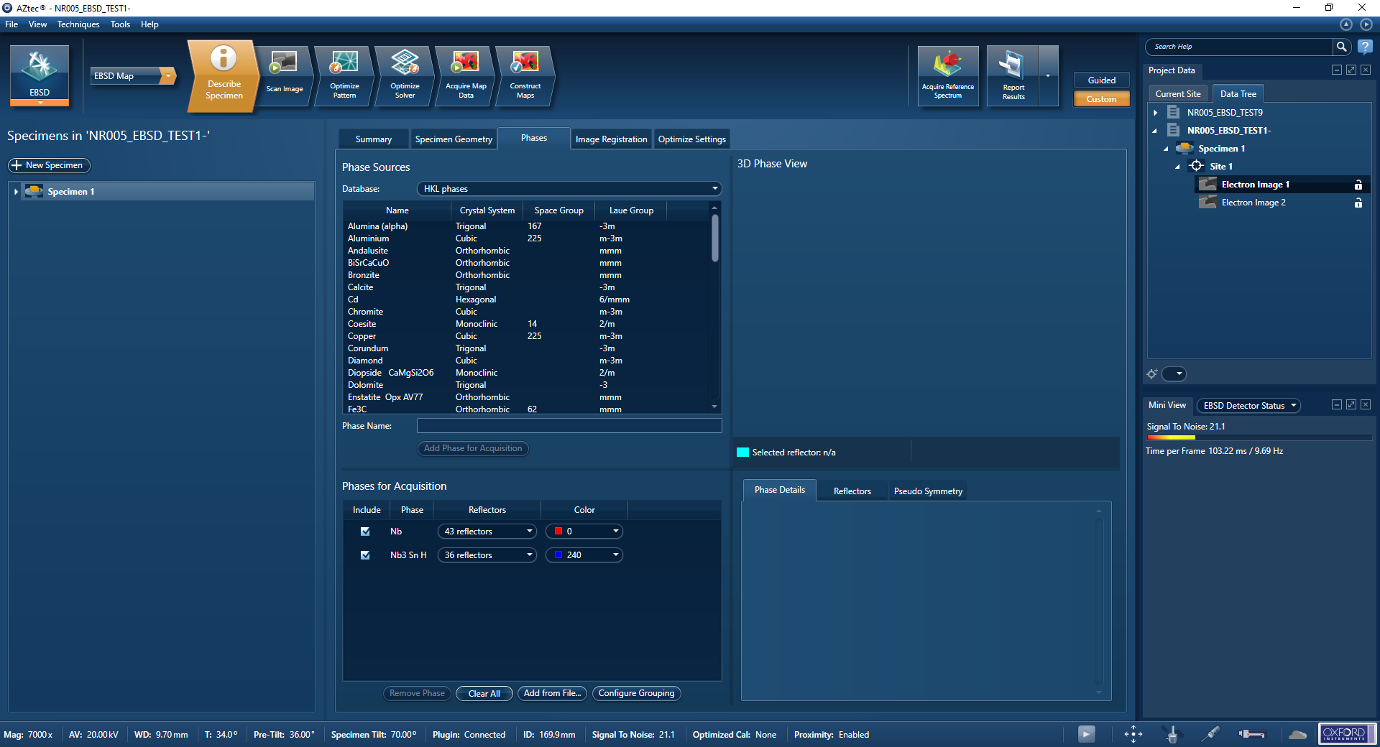
Aztec Setup – Add Phases
Continue to the ‘Phases’ tab and add Nb and Nb3Sn to the phases for acquisition.

Slide 20
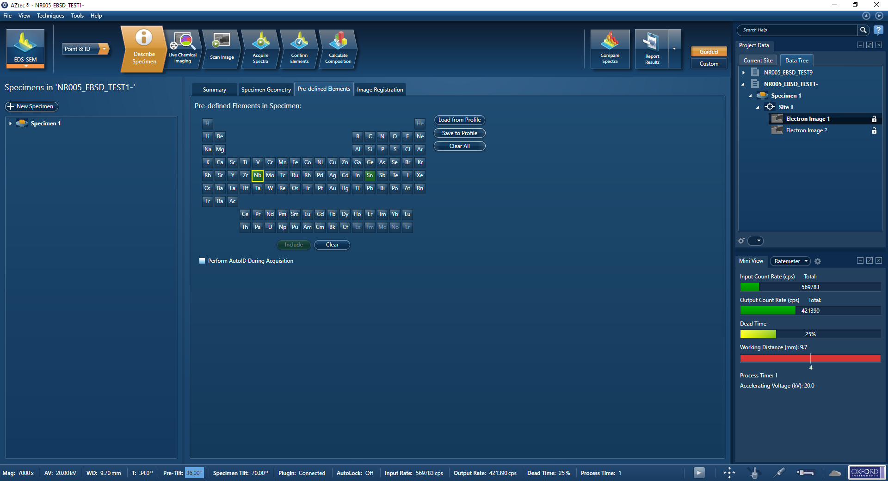
Aztec Setup – Set Elements For EDS Acquisition
Switch to the EDS-SEM mode and select Nb and Sn in the Pre-defined elements section.
Uncheck ‘Perform AutoID During Acquisition.’

Slide 21
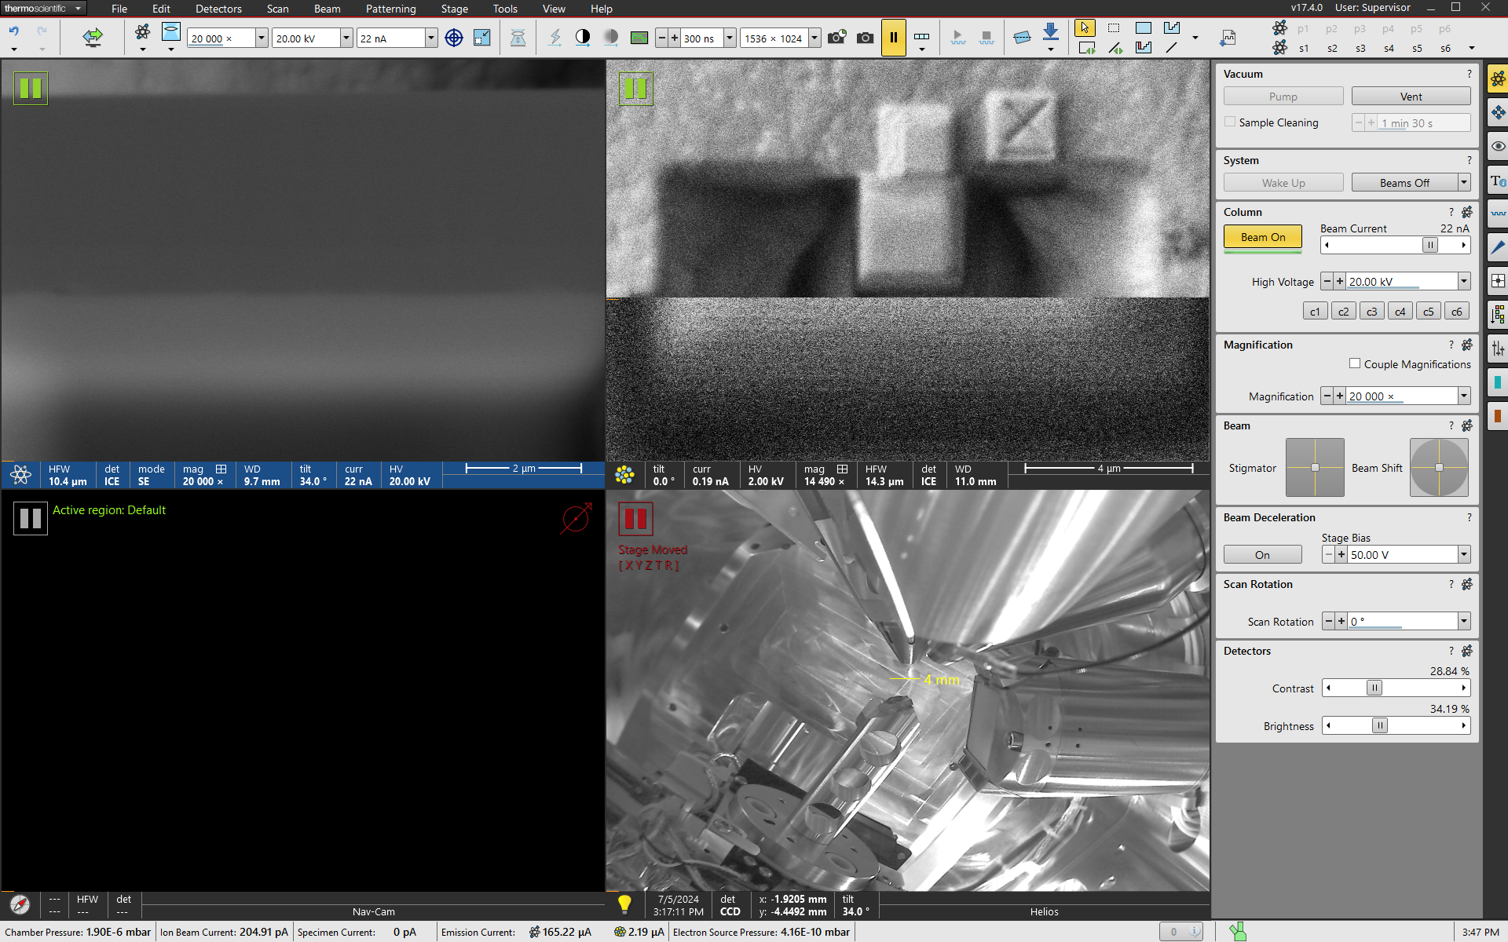
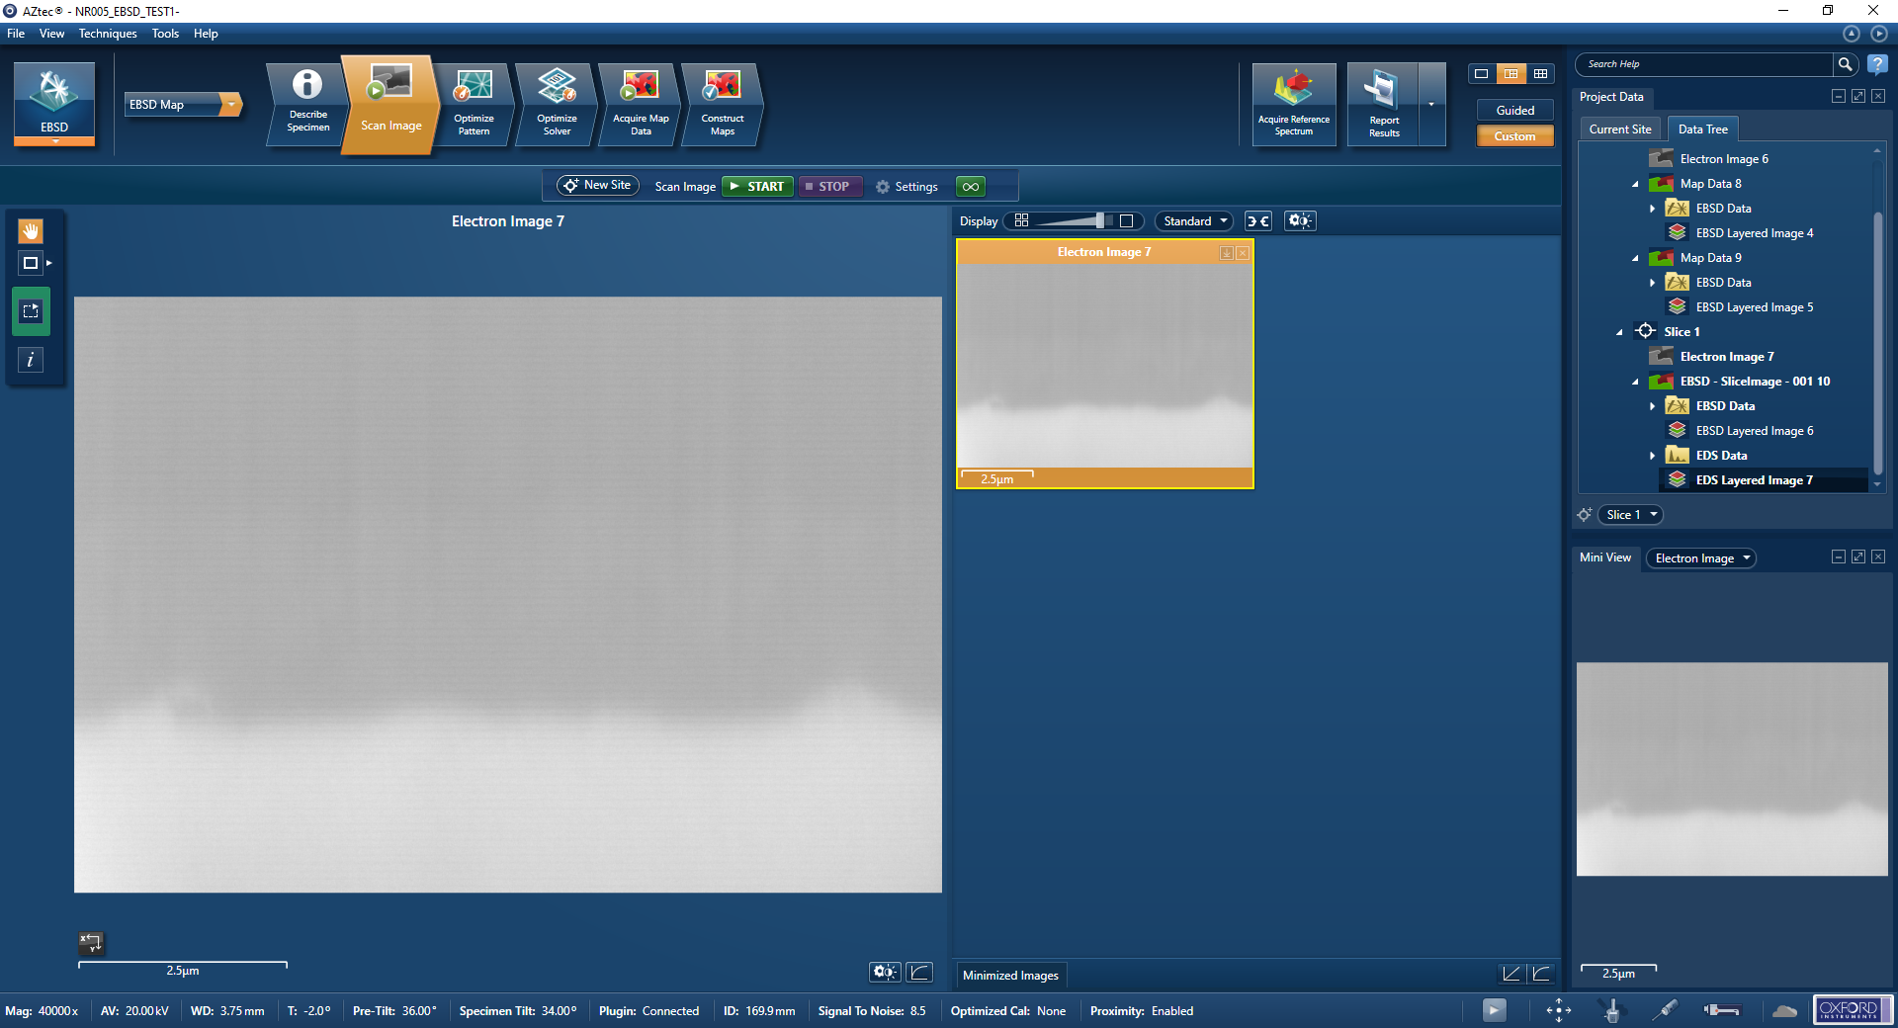
Aztec Setup – Select Scan Area
Return to the EBSD mode and adjust the SEM field of view on the cut face of the sample.
Zoom in until the width of the SEM image is about the same as the width of the sample.
Activate the tilt correction feature in the Aztec software.
Start the electron image acquisition.
Zooming out the acquisition area may allow for easier image alignment but will increase the total measurement duration.

Slide 22
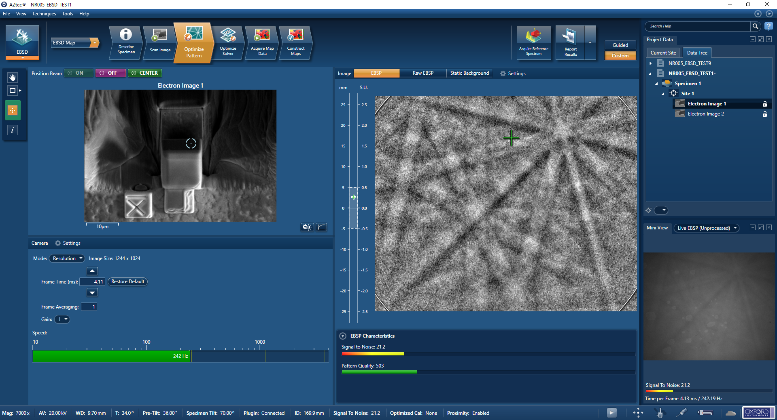
Aztec Setup – Optimize EBSD Pattern
Adjust the EBSD pattern settings to get a clear pattern.
Activate both static and dynamic background subtraction.
A lower speed is recommended to allow for a higher EDS X-ray count.
If the pattern is clear and the sample is still not well indexed, increase the fine polishing duration.

Slide 23
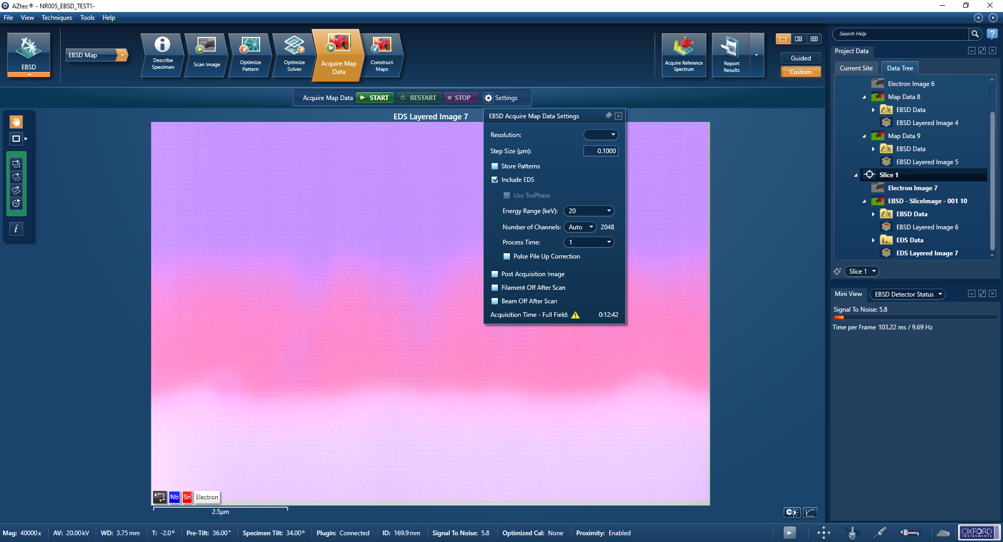
Aztec Setup – Set EBSD Map Settings
Proceed to the ‘Acquire Map Data’ tab and adjust the image settings.
Check the ‘Include EDS’ box.
Set the step size to be equal to the slice thickness in ASV so that the 3D voxel size is uniform.
Click the start button once to save the current settings for ASV. You do not need to finish the scan for the settings to save.

Slide 24
ASV EBSD Setup
Once Aztec is setup, zoom out the SEM image without moving the stage until the fiducial mark is visible in the field of view.
In the ASV window click on ‘Prepare Image’.
Align the fiducial mark and click ‘Find Fiducial.’
Once all the imaging steps have a green checkmark, you may hit the RUN button to start the imaging.

Slide 25
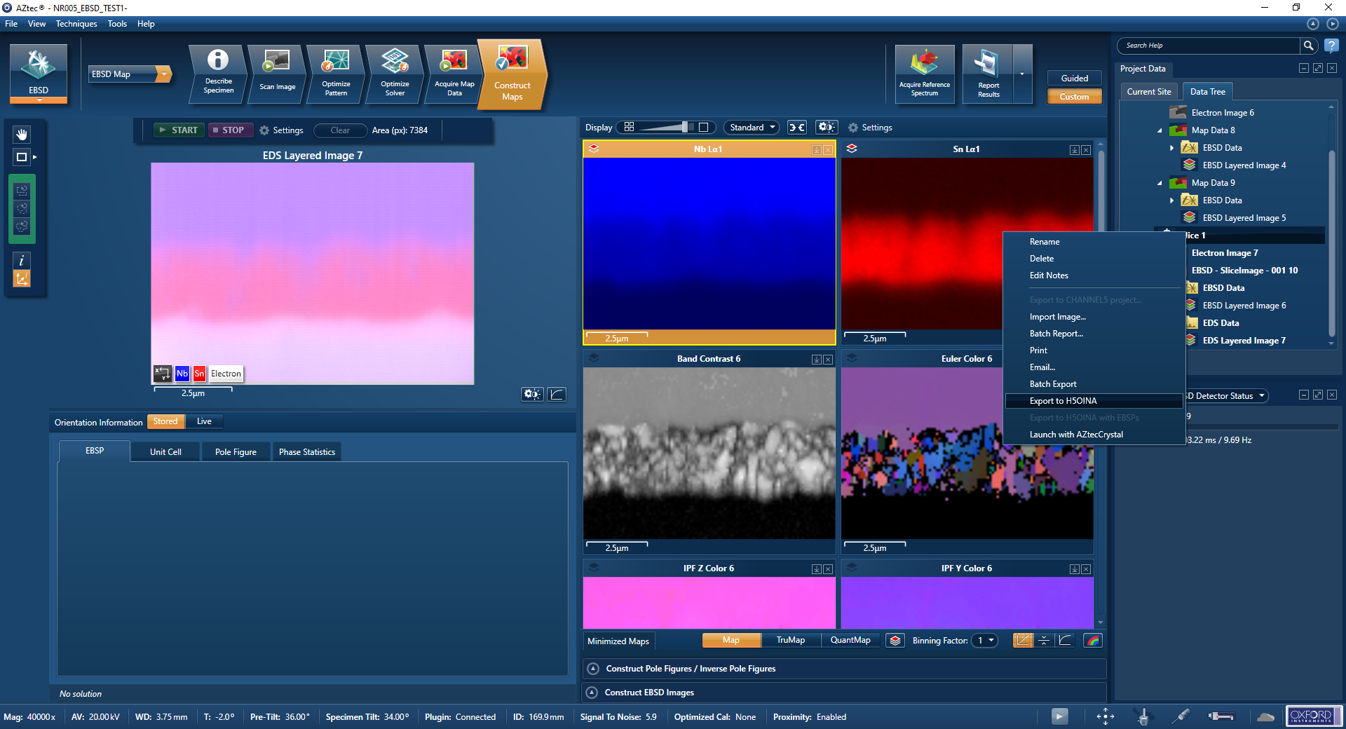
Aztec Setup – Exporting Slice Data
Once the ASV software has finished you may export the EBSD/EDS data from Aztec by selecting all the slices and right clicking then selecting the ‘Export H5OINA’ option in the dropdown menu.

